Slide 1
Next Steps Using Mendix in Your Classroom
1. Request more info & schedule a consultation phone call: https://www.mendix.com/university-program/
2. Review Professor online learning path & curriculum resources: https://gettingstarted.mendixcloud.com/link/path/35
3. Review Student Learning Path + Free Certification Exam: https://gettingstarted.mendixcloud.com/link/path/31
4. Request Free Certification exams for professors & students: Email University@Mendix.com

Slide 2
Our Mission
Students need to build real working solutions
Find talent for our expanding customers + partners
Agile + Tech + Business Savvy
Mendix is an enterprise grade tool:
Not just a prototype tool
Students can deploy and share their apps
All FREE!
We are here to support your learning objectives

Slide 3






Global University Program
140+ Professors
8+ countries
107+ universities
400% YoY growth
The Mendix University Program Inspires the next generation of tech-savvy business students to build real world solutions & we empower them with tools and knowledge to become the bridge between business & IT in companies around the world.
Open Curriculum
Faculty Professional Development
9,000+ students
Free Mendix Certifications
Used by leading schools worldwide

Slide 4

MIT
Major | Open
Class | Special Topics in Computer Science
Assignment | Solve an Open Business Problem
Students | Open
https://mitrad.mendixcloud.com/

Slide 5

Bentley
Major | Class | Assignments | Students
Computer Information Systems | Introduction to IT | Paper planes – Agile and Waterfall Simple application | Freshman
Computer Information Systems | IT Project Management | Students Group Projects | Seniors

Slide 6

Concordia University
Major | Class | Assignments Examples | Student Level
Computer Science | Introduction to Programming | Hello World Loops and general principles | Freshman
Computer Science | Senior Capstone Project | Complex Apps with ML and 3rd party integrations | Seniors
Information Systems | System Analysis and Design | Customer + Project | Graduate

Slide 7
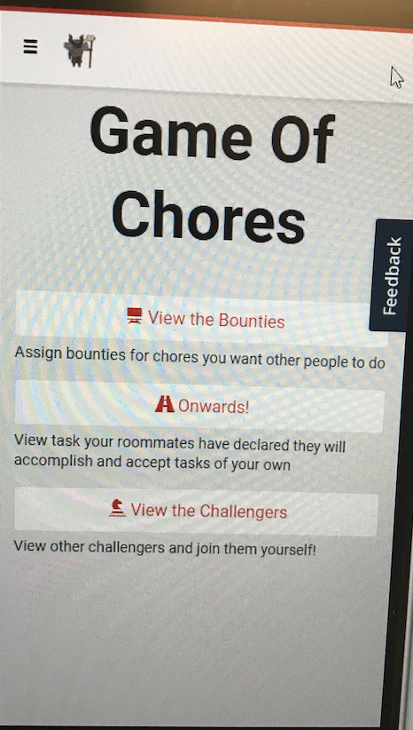
Boston University
Major | Class | Examples | Level
Questrom School of Business - IS Minor | Web App Development | Individual Assignments | Juniors + Seniors
Observations:
Introduction Guest Lecture
Students used the Web Modeler
3 Lectures + 2 weeks development
Very creative Applications:
Game of Chores
Assassins Hideouts
Save the Children
BU Tutors Planning
Student Organizations

